Slide 1

Forecasting Covid-19 cases using SARS-Cov2 Titers in Wastewater
CS-109B: Group #111
Spring 2021
TEAM
Vivek Bhatia
Prakash Bhatt
Lalitanjali Bondili
Raghu Soori

Slide 2
CONTENTS
Introduction
Data Description
Data Pre-Processing
Exploratory Data Analysis
Models Explored
Model Validation
Conclusion & Next Steps

Slide 3
Introduction
Conventionally COVID-19 is tracked via symptomatically and clinically diagnosed cases. This method has inherent drawback as many of the patients do not report the disease.
Recent developments in detecting COVID-19 cases have led to techniques such as measuring viral titers in urban wastewater as a method to track and forecast COVID-19 cases.
Longitudinal wastewater analysis can be used to predict COVID-19 cases more accurately and more instantaneously than clinical data.

Slide 4
Project Proposal
We intend to explore and establish the relationship between wastewater surveillance data collected and maintained by the Massachusetts Water Resources Authority, and the outbreak of COVID-19 in the neighboring communities.
We used supervised learning techniques to develop models which can closely predict the current count of COVID-19 cases in the community using solely the data available from wastewater viral titers

Slide 5
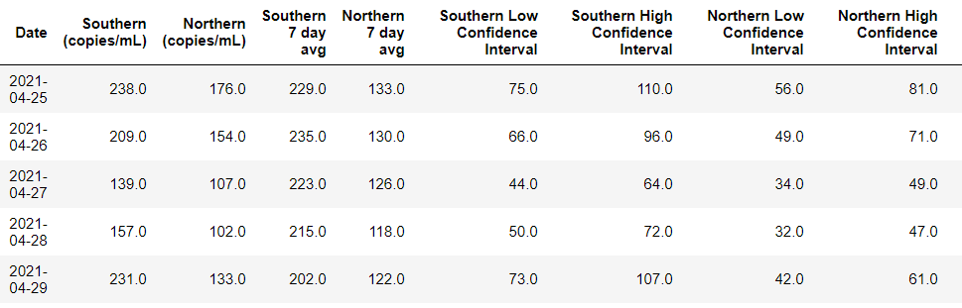
Data Description
MWRA Wastewater COVID-19 Tracking Data - Collected by Massachusetts Water Resources Authority measuring the quantity of COVID-19 viral RNA samples in sewage wastewater for Boston’s Southern and Northern districts
TAKE AWAY
Southern 7-day average and Northern 7-day average are the primary predictor variables used in models
Notice how these variables are the rolling averages of titer values for every 7 days

Slide 6
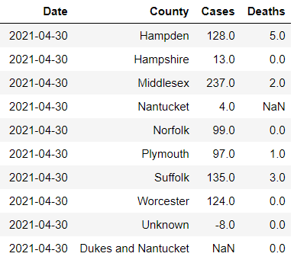
Data Description
Massachusetts official COVID-19 Case Count: Publicly available dataset provided by the Massachusetts Department of Public Health
TAKE AWAY
Our models are trying to predict the number of cases per day
Since our predictor variables are 7-day rolling averages, we have computed “Cases_Avg” which is the 7-day rolling average of the number of cases. We use this as the response variable.

Slide 7
Data Pre-Processing
Write something about
df_covid.interpolate(method="akima", limit_direction='both', inplace=True)
Dropped nan values
Do we need to write about NORMALIZATION here? MinMaxScaler?
Vivek update this slide
Notes:
Now coming to data processing,
Our target variable has different interpretations for positive and negative values.
so we used an absolute value where lower number would indicate high mortality risk and higher number would indicate lower risk.
For identifying race, we used the distribution of race in 70s and for sex, we leveraged the fact that males and females have different ranges for some of the clinical variables like RBC.
For filling in the missing data in our dataset, we used an iterative imputer.
We added some new flags indicating predictors outside of normal range. e.g. if a person had high BMI, we would either flag it as 1 or 2 depending on the range and then used a sum_flag that would add up these flags to indicate an overall health of a person.

Slide 8
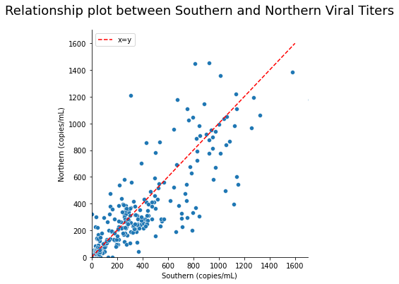
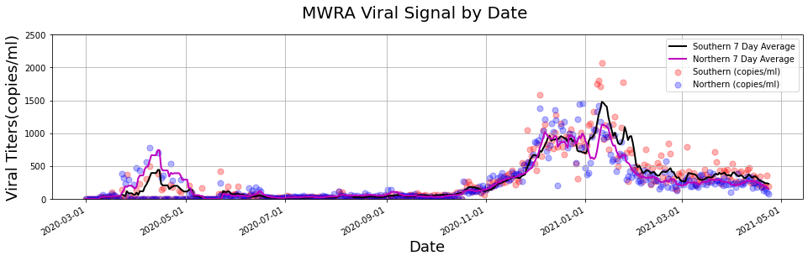
Exploratory Data Analysis
TAKE AWAY
Strong linear relationship between Southern and Northern titer data
We also see that Southern and Northern titers have a strong positive correlation when plotted w.r.t date

Slide 9
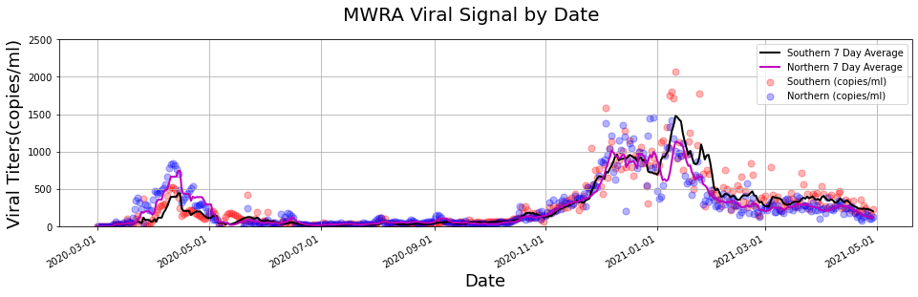
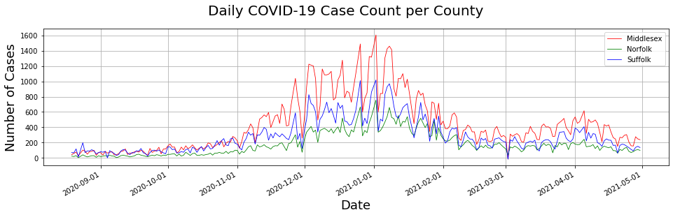
Exploratory Data Analysis
TAKE AWAY
Notice that the 7-day average titer values from the top graph follows the same trend as the cases per county from the bottom graph

Slide 10
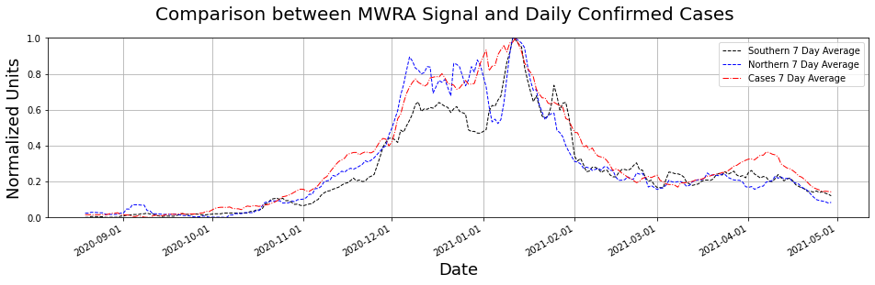
Exploratory Data Analysis
TAKE AWAY
Since there is a strong relation between the Southern 7-day average, Northern 7-day average and the Cases 7-day Average, we use the first two variables to predict the latter

Slide 11
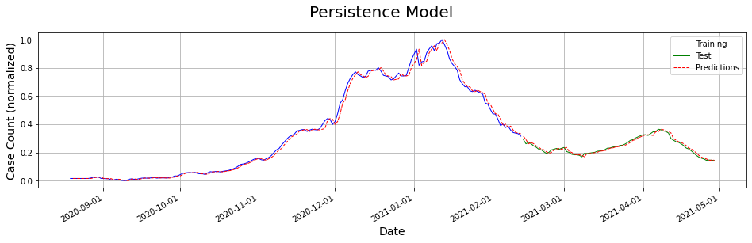
Models Explored: Persistence Model
Phrase this better
TAKE AWAY
TAKE AWAY
The persistence model considers that the Covid Case Count at t + 1 is equal to the Covid Case Count at t.
We use the persistence model and assume that there is a relation between the average of last 7 covid case values and the next response variable.

Slide 12
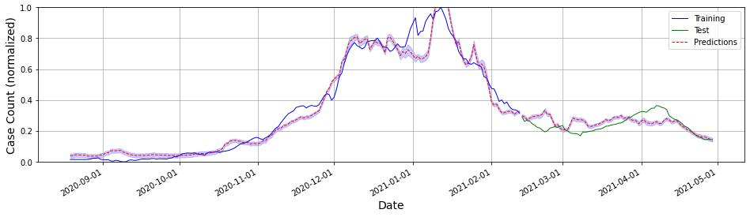
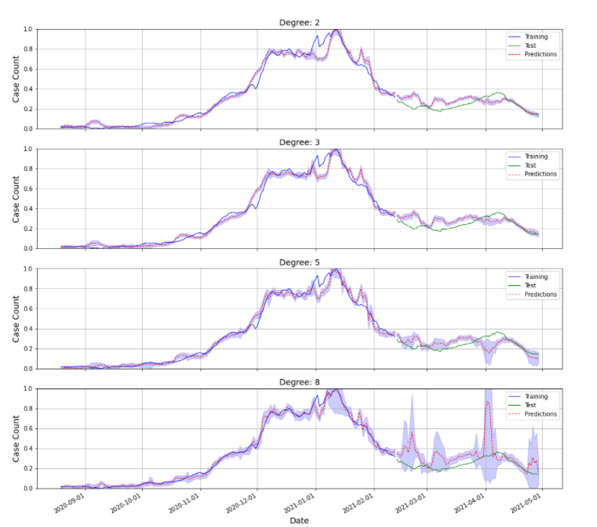
Models Explored: Linear and Polynomial Regression
Linear Regression
Polynomial Regression
TAKE AWAY
Increase in polynomial degree increases the variance in predicted values which is a result of overfitting
Linear Regression performed better with respect to the polynomial regression models

Slide 13
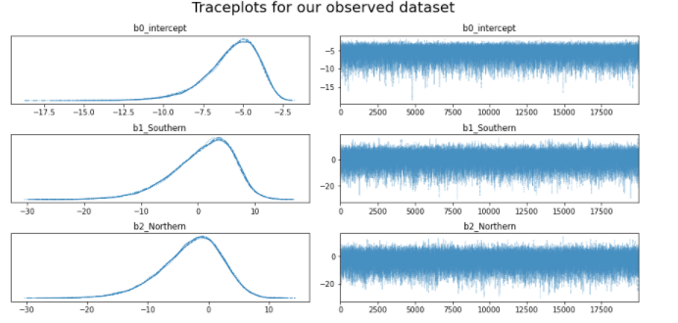
Models Explored: GLM Poisson
Vivek, please update this slide.
Slide for GLM Poisson
TAKE AWAY
Point 1
Point 2

Slide 14
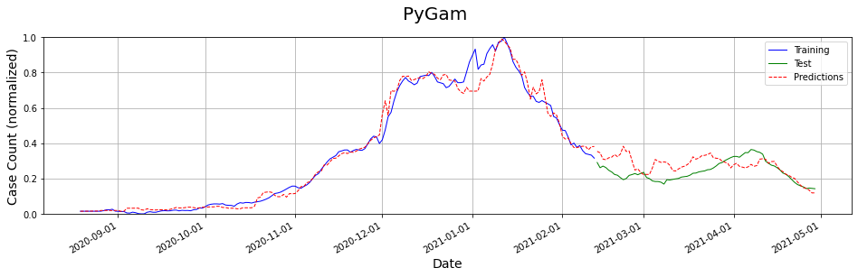
Models Explored: PyGAM
Vivek to update this slide
Slide for PyGAM
TAKE AWAY
Point 1
Point 2

Slide 15
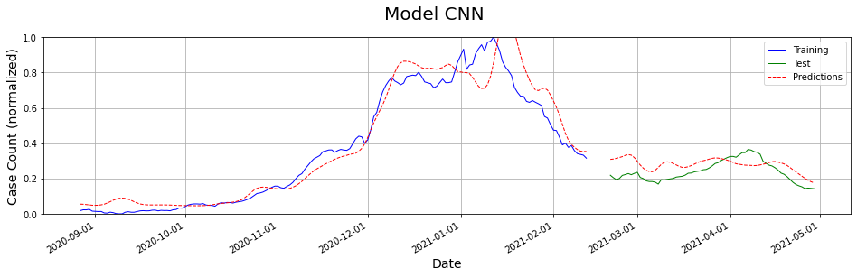
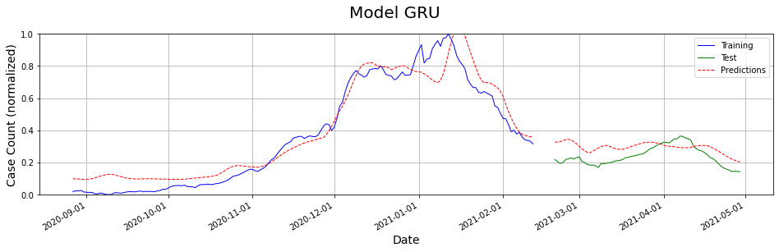
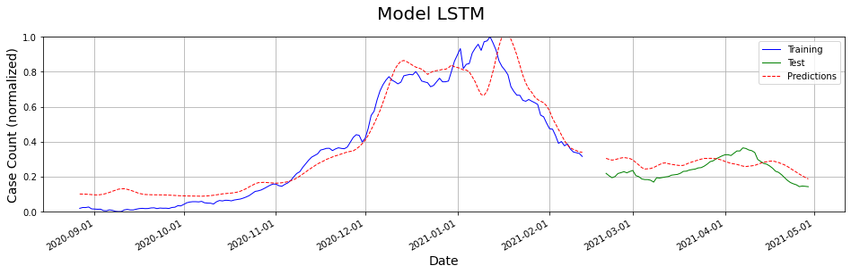
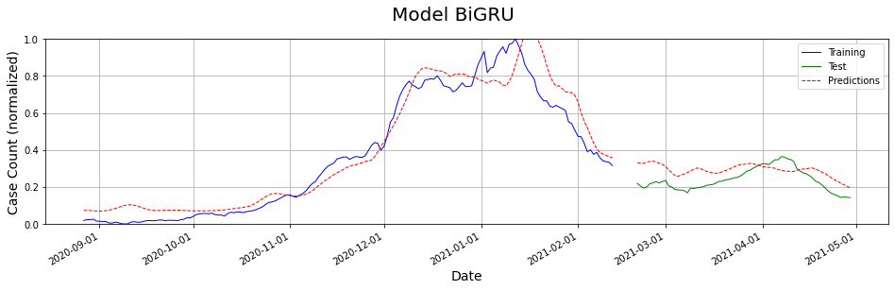
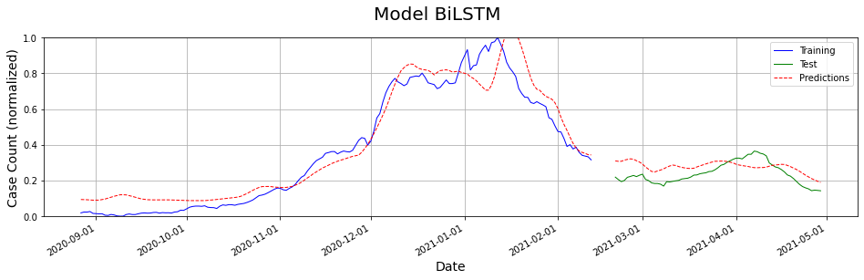
Models Explored: Deep Learning Models
Update graphs with better results if any
TAKE AWAY
All the deep learning models provided very similar results
The predicted values are lagged by 5-6 days when compared to the train and test set

Slide 16
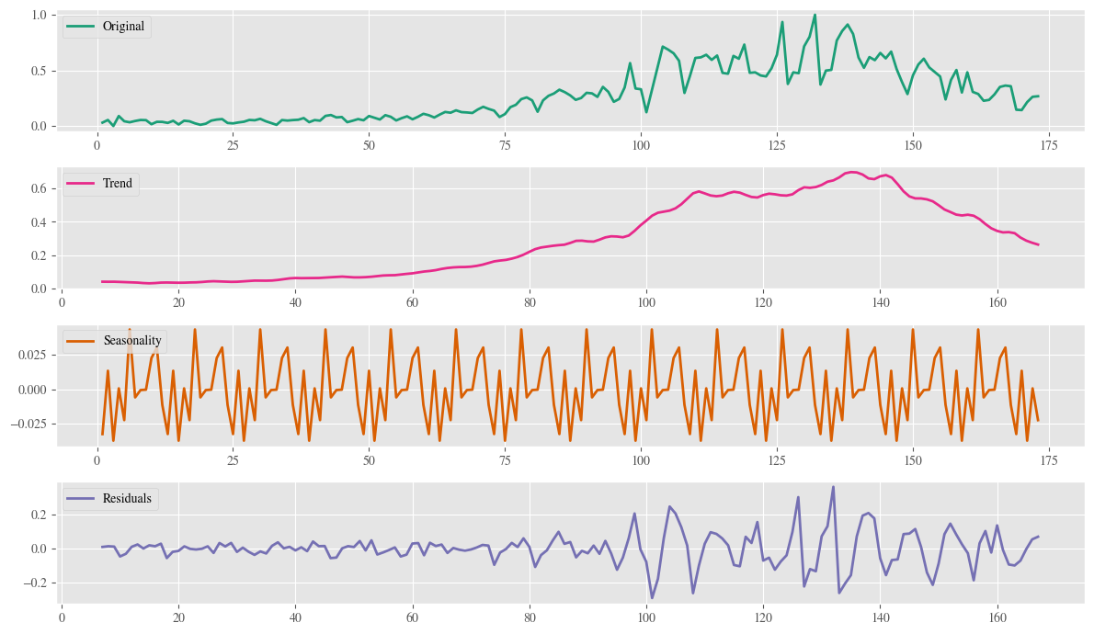
Models Explored: Time Series Analysis
TAKE AWAY
On decomposing the training data into trend, seasonality and residuals, we see that there is seasonality in the data
This encouraged us to split the data variable into day-of-week, day-of-month and month and investigate the models further

Slide 17
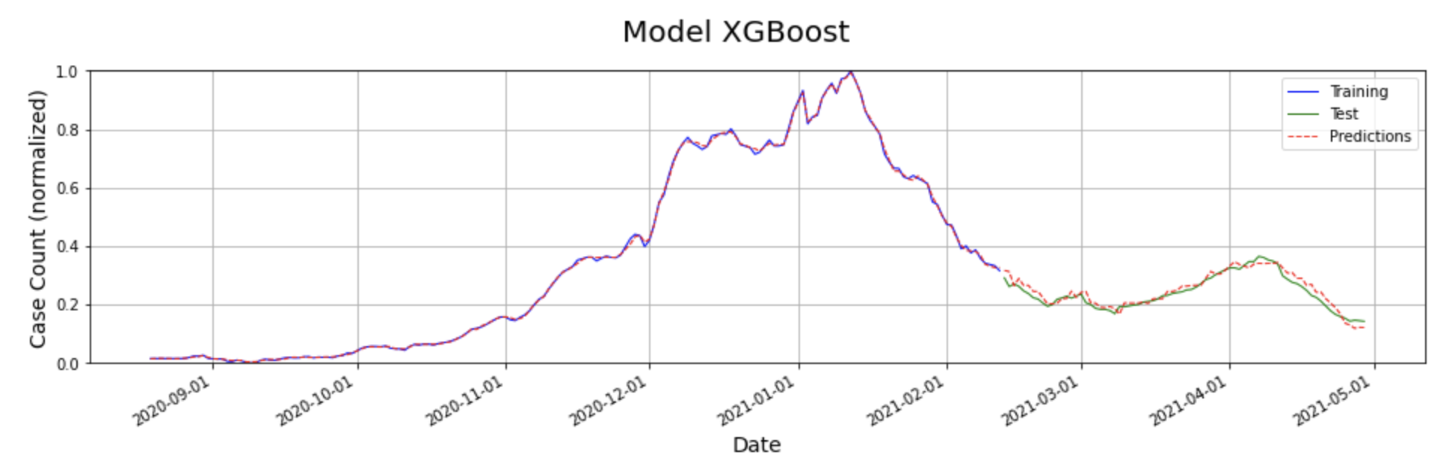
Models Explored: XGBoost
TAKE AWAY
The model predicts the training and test data with better precision when compared to the other models.
Accounting for seasonality by incorporating multiple date related variables has resulted in better predictive capabilities of the model

Slide 18
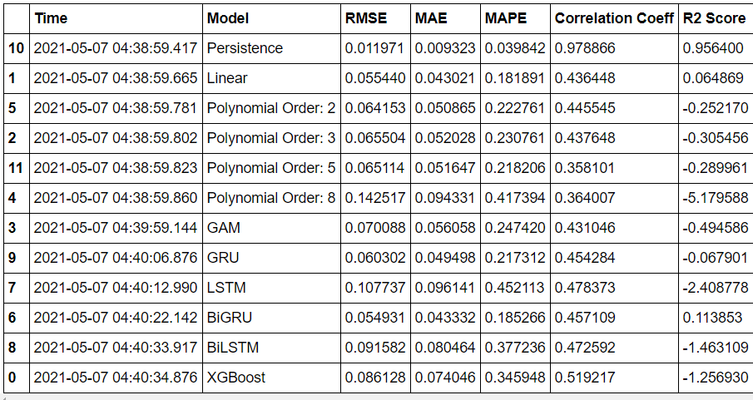
Models Explored
Run all models and update output
TAKE AWAY
Since this is a regression problem with a strong underlying linear relationship, RMSE, MAE and MAPE have been used to compare models.
While persistence model has performed very well, XGBoost is a close second with a low RMSE of 0.01.
The R-Squared values of Persistence, XGBoost and CNN are highly positive indicating that the predictor variables have been able to explain the variance in the response variable well.

Slide 19
Conclusion
Adding the output of the persistence model as an input variable has improved the predictive capabilities of all models. This shows that there is a significant relation between covid cases counts of the future and the past. We have predicted a particular day’s case count using the previous day’s case count.
RMSE, MAE and MAPE have been used as the metrics to compare models.
Time series decomposition of the training data shows that there could be an underlying seasonal factor in the data. We accounted for this by splitting the date variable into day-of-month and day-of-week.

Slide 20
References and Special Thanks
Wu et al. SARS-CoV-2 titers in wastewater foreshadow dynamics and clinical presentation of new COVID-19 cases (2020 doi: https://doi.org/10.1101/2020.06.15.20117747)
https://www.mwra.com/biobot/biobotdata.htm
https://www.mass.gov/info-details/covid-19-response-reporting#covid-19-interactive-data-dashboard-
Yang et al. Accurate estimation of influenza epidemics using Google search data via ARGO (2015, https://doi.org/10.1073/pnas.1515373112)
Special Thanks
We would like to say special thanks to
Dr. Mauricio Santillana,
TF of the 109b – Prof Protopapas, Glickman, Tanner
Teaching Assistants

Slide 21
THANK YOU

